Slide 1
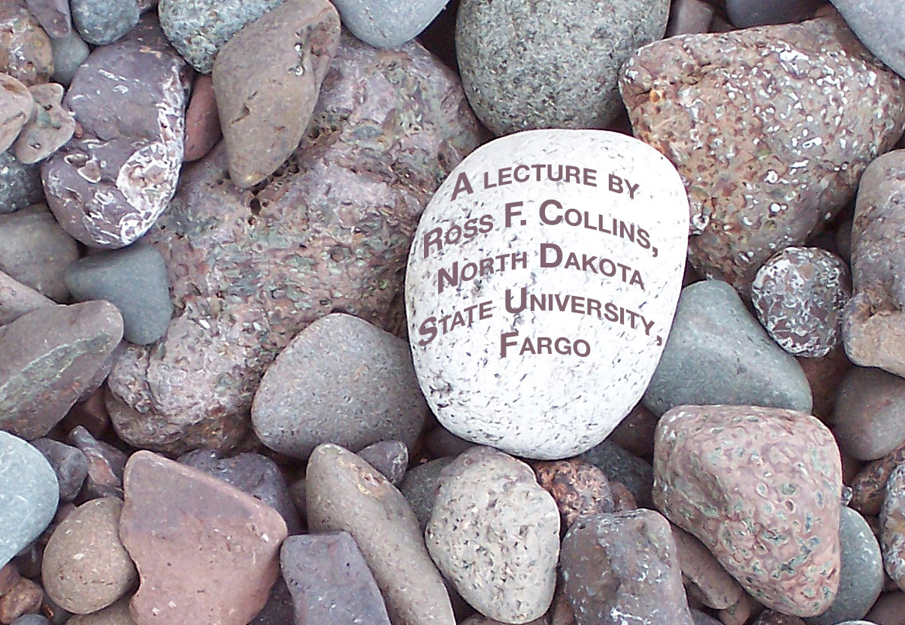
Photojournalism
People doing things

Slide 2
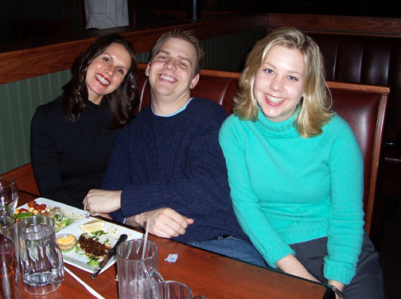
World of photography
We rely on photography for a huge number of ways to communicate visually.
For most of us, photography serves as a way to capture and preserve memories.
This is as far as most of us go as photographers.

Slide 3
Professional photography
Others use photography for technical purposes, such as illustrating technical information.
Studio and portrait photographers offer polished views reflecting professional standards to capture our memories.
Artists use photography to communicate their vision.
Advertisers use photography to sell things.

Slide 4
Photojournalism
But photojournalists use photography for another purpose: to tell a story.
The approach is similar to that of journalists.
A reporter tells a story using words based on accepted news values.
A photojournalist does the same thing, based on a universal language, pictures.

Slide 5
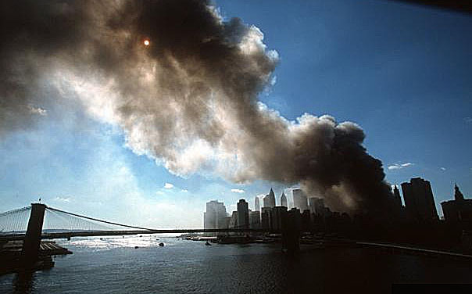
Photojournalism
Secondly, photojournalism differs from other kinds of photography because it is used for a mass medium.
Unlike those of us who take family snaps, photojournalists are expected to communicate to people they do not know.

Slide 6
Photojournalism
Actually, the idea that photojournalism ought to be a separate field is fairly recent.
The word “photojournalism” was not coined until the 1940s, by journalism historian Frank Luther Mott.

Slide 7
Photojournalism
Before the 1930s, editors did not consider the power of photography.
The words were important; photos were extra.
Today most editors will not accept stories without photos, illustrations or video. We live in a photo-saturated world.

Slide 8
Photojournalism
Photojournalism, of course, is a non-fiction creation. We are supposed to believe photojournalists, like journalists, to be dealing with facts.
This has led to controversy over the extent of manipulation permissible using software such as Photoshop.
If you can make a change, should you?

Slide 9
Photojournalism
Can you crop the background? Can you darken a face? Can you remove the light pole?
There are no rules, but we do have a guideline as photojournalists: Don’t lie.
What about the next slide? Fact or fiction?

Slide 10
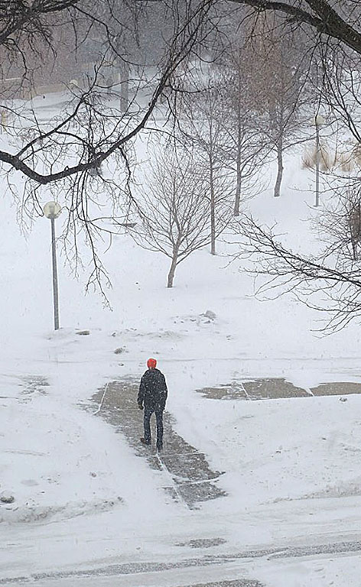
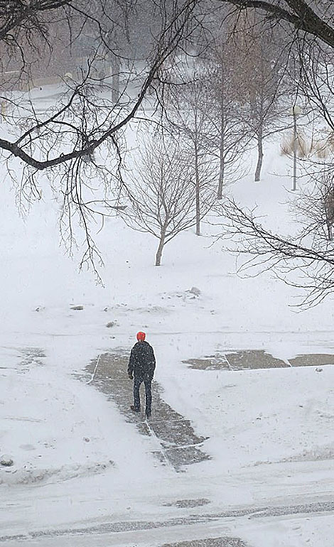
Photojournalism
Okay to remove the pole?

Slide 11
Photojournalism
The debate over what is permissible is important because photojournalism has so much power.
Words communicate in a language bound by the culture that created it. They add context, explain, talk about the past and the future.

Slide 12
Photojournalism
Pictures, on the other hand, appeal to a universal visual language which transcends culture.
They have no past. They have no future.
They show one instant pulled from the human sea, a “slice of life.”

Slide 13
Photojournalism
Meaning in words is gained through methodological reading, in linear fashion.
Meaning in pictures is conveyed all at once.
Photo reach beyond reason to directly strike our emotions.

Slide 14
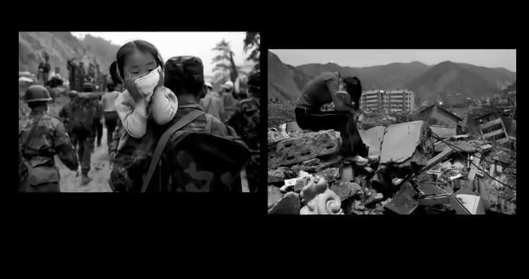
Photojournalism
What is photojournalism? Top photographers explain. http://www.youtube.com/watch?v=XONXeUndHl8

Slide 15
Photo memory
Many of us who grew up with media can’t remember a particular article or television show about an event.
But if we think of that event, we may recall a picture instead.

Slide 16
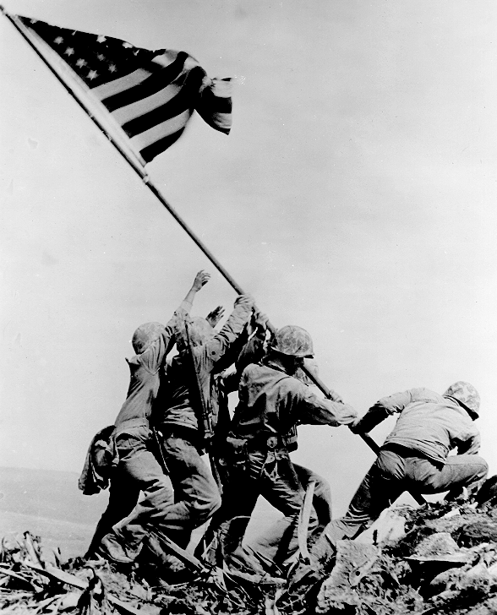
Events in photography
For example, many people remember World War II through the famous Rosenthal photo of Iwo Jima.

Slide 17
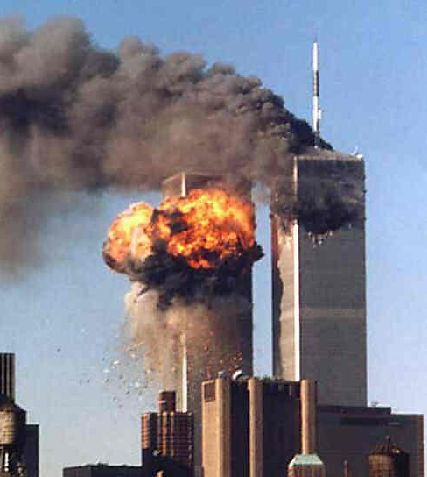
Events in photography
More recently, many people recall the terrorism of Sept. 11, 2001, based on this image.
Such images become icons of our time, defining events for us with more power than the words.

Slide 18
Photojournalism jobs
Who took these photos?
Photojournalists work for a variety of publications or agencies.
Most widespread employer of photojournalists are newspapers.

Slide 19
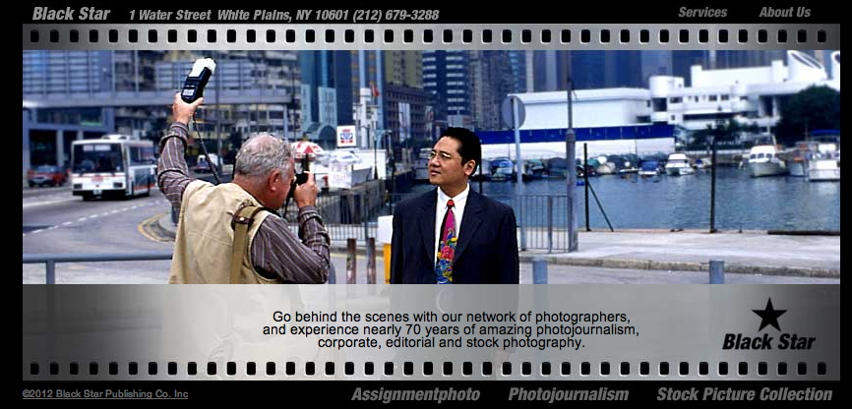
Photojournalism jobs
Other photojournalists work for agencies or syndicates.
Black Star is one well-known agency staffed by photojournalists who prowl the world for news images.

Slide 20
Photojournalism jobs
Magazines may have staff photographers. But usually they hire free-lance photojournalists.
Many photographers find free-lancing the most exciting and independent way to produce images. But becoming established is tough. Most began as newspaper photographers probably working in both print and online.

Slide 21
Photojournalism jobs
Unlike most studio photographers, photojournalists are expected to be more versatile.
They should know technical, portrait, studio and street photography.
More and more they need to know video photography, as the Web becomes a dominant place to display their work.

Slide 22
Photojournalism
The top of the heap is the free-lancer who does jobs for the great photo publications, such as National Geographic, or great agencies such as Magnum Photo.
But lots of photojournalists free-lance part time.

Slide 23

The free-lance game
Even you can be a free-lance photographer: professionals can’t be everywhere, and most news operations will pay for professional-quality photos of a major news event.
Take your DSLR with you everywhere. Consult the Photographers’ Market for places to sell your work.
You may wish to specialize in areas such as sports or nature.

Slide 24
Stock agencies
Some photojournalists shoot mostly for stock.
Stock agencies offer fairly generic images used mostly by magazines.
Editors turn to stock to save money over hiring a free-lancer.

Slide 25
Stock vs. web
Many editors prefer to work with stock agencies because they offer top-quality work, with all legal permissions secured.
Images pulled from the web often can’t be legally used in print without permission and royalty fees.
In particular, photos for advertising must be backed by legal releases.
Generic digital clip art usually does not meet professional standards.

Slide 26
Careers
So what is a photojournalism career like?
It is perhaps the most exciting of all journalism jobs.
Reporters can get their stories on the phone, or by email. Photographers have to be there.
Photojournalists have access to top sports teams, big celebrities, and places an average person never gets to see or experience.

Slide 27
Careers
Photojournalists may literally see the world, from Kosovo to Karachi.
But it’s not easy to break into the field.

Slide 28
Careers
Photojournalism is in fact not a growing field, despite the proliferation of visual images in the media. More media are cutting photo staffs, often relying on “crowd sourced” photos from readers.
Digital cameras make it easier for anyone to take a technically proficient photo, and people can just upload to the Web without needing to process film. But can amateurs do what professionals can do? Often not.

Slide 29
Careers
Most photojournalists have a university degree, usually in journalism. They have at least one or two good internships. They have a strong file of clips from photos they took for student publications or programs.
It’s a career that demands sacrifice and passion. But few careers are more exciting.

Slide 30
Other photojournalism
If course, a lot of people who work in media-related fields may not be photojournalists—but still are expected to produce professional-quality photos.
More and more media operations are asking reporters to take photos and video.
In public relations, professional photo skills may be highly valued. PR operations seldom have staff photographers.

Slide 31
Value of the skill
All students interested in a media-related career should include some photography in their portfolio.
The ability to take respectable photos—and to understand the standards of what’s respectable—may mean the difference between getting the job or not.
How to get started? Consult Ross’s Ten Tips for Photojournalists. Website link: http://www.rossfcollins.com/242photojournalism/Principles.html

